Slide 1


ROCKBUSTER STEALTH DATA ANALYSIS
Prepared by Munavvar Makhkamova
July 7, 2022

Slide 2
Overview of Data Analysis
GOAL
TOOLS USED
SUMMARY OF FINDINGS
Development of a strategy for transitioning Rockbuster Stealth into online video rental company in order to remain competitive with other streaming services (i.e. Netflix, Amazon Prime)
SQL – to retrieve the necessary data from the database, Excel- to collect data from SQL and analyze it, Tableu – to create visualizations
It was found that the sales vary greatly among the regions and countries like India, China and United States bring the highest revenue. Most of the customers preferred more mature movies rated PG-13, NC-17 or PG and the most popular genre was sports, followed by sci-fi and animation. Average rental duration was 5 days.

Slide 3

Key Business Questions
01
Which movies contributed the most/least to revenue gain?
02
What was the average rental duration for all videos?
03
Which countries are Rockbuster customers based in?
04
Where are customers with a high lifetime value based?
05
Do sales figures vary between geographic regions?
05

Slide 4
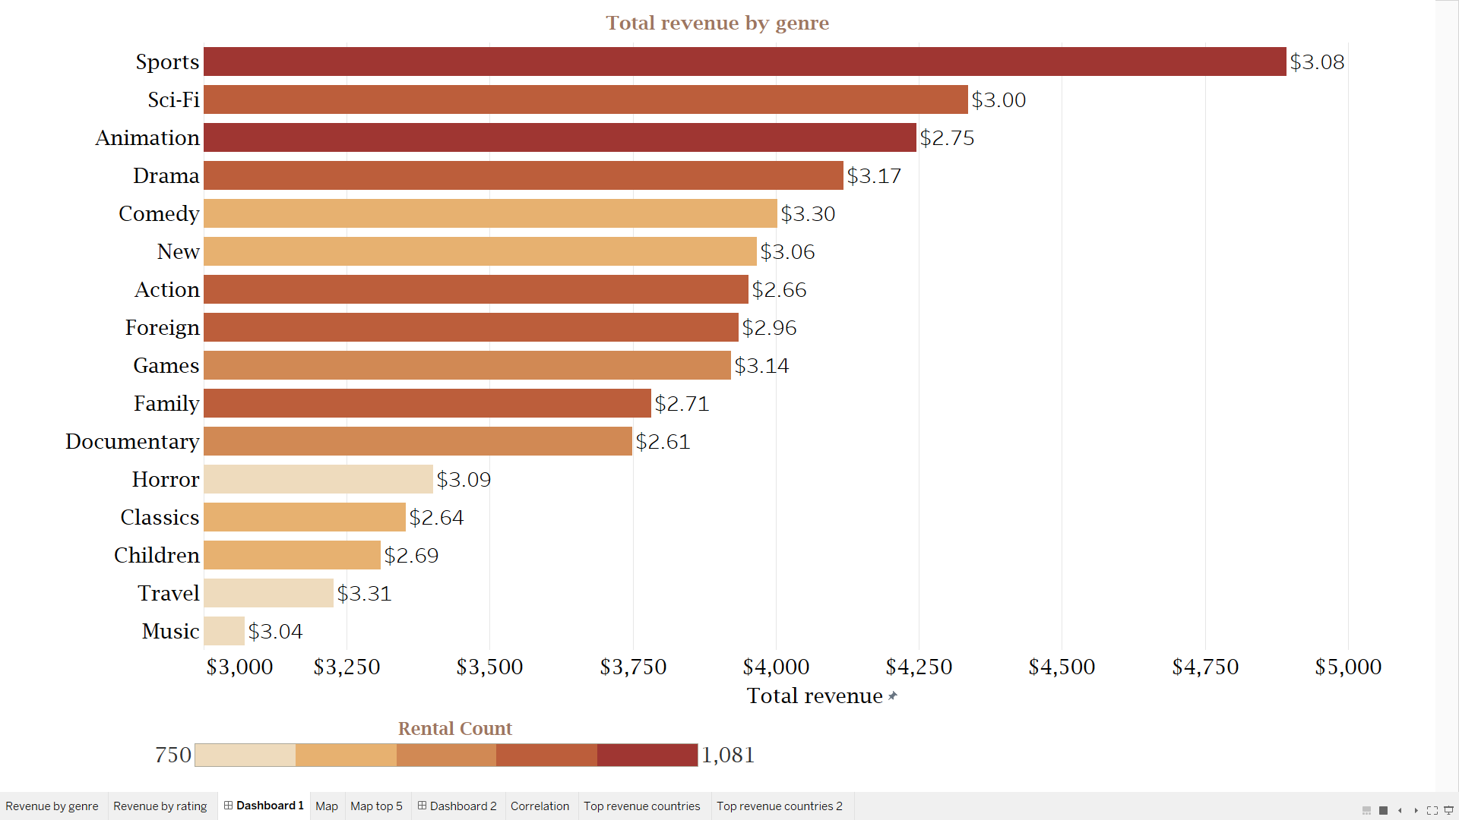
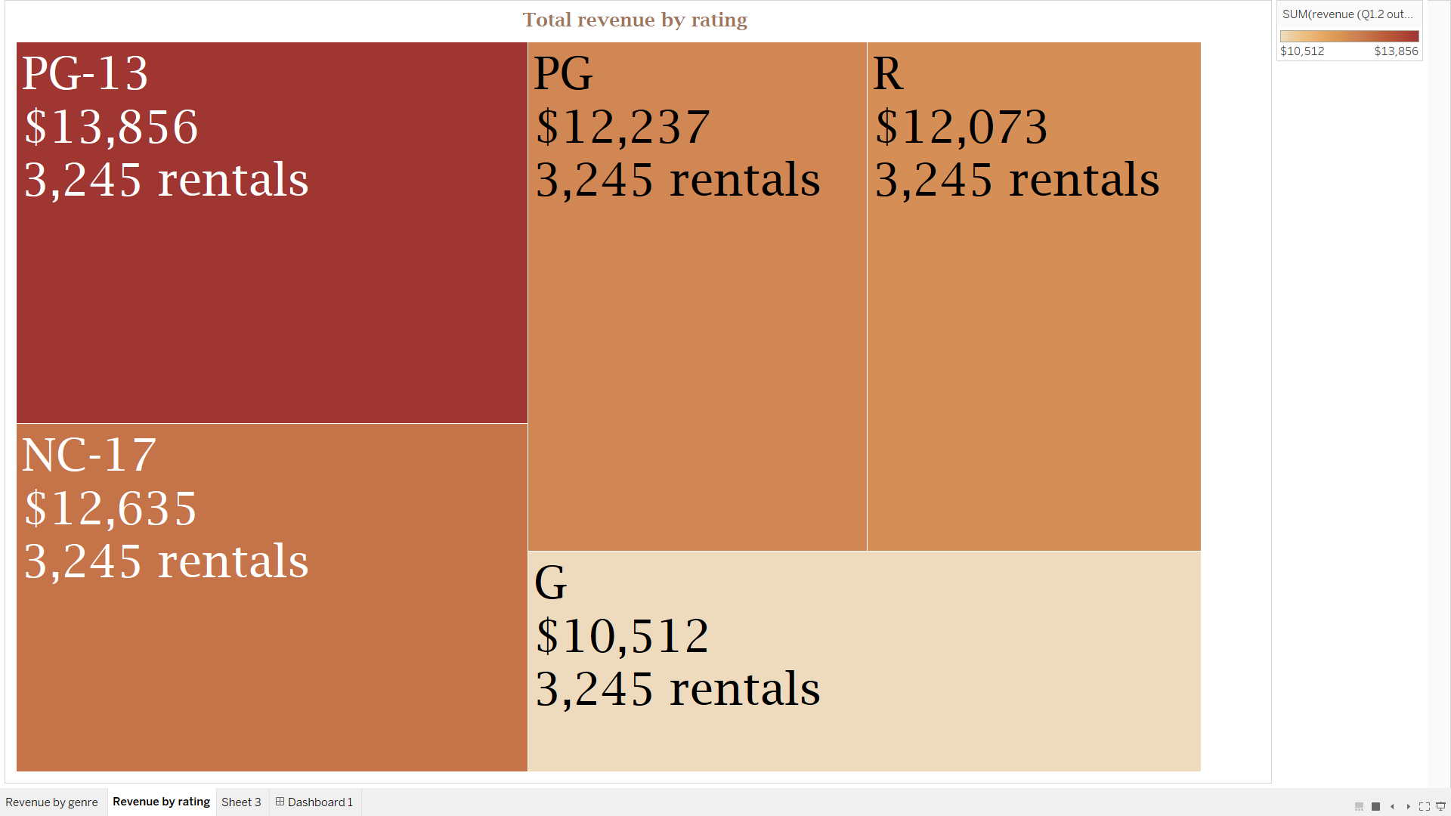
01
Which movies contributed the most/least to revenue gain?
Total revenue by genre
-The highest revenue generating genres include sports, sci-fi and animation with the total revenue of almost $5,000.
-The lowest revenue generating genres include Children, Travel and Music with total revenue lower than $3,300.
-Movies for adults are more popular with PG-13 having the highest revenue, followed by NC-17 and PG.
Revenue for animation is lower than sci-fi because its rental rate is lower($2.75) than sci-fi($3.00)
Total revenue by rating
Music has the lowest revenue in general, however, the movie with the highest revenue is also in this genre

Slide 5
Top 10 movies with highest revenue
Top 10 movies with lowest revenue
№ | Title | Revenue | Rentals | Genre | Rating
1 | Telegraph Voyage | 215.75 | 25 | Music | PG
2 | Zorro Ark | 199.72 | 28 | Comedy | NC-17
3 | Wife Turn | 198.73 | 27 | Documentary | NC-17
4 | Innocent Usual | 191.74 | 26 | Foreign | PG-13
5 | Hustler Party | 190.78 | 22 | Comedy | NC-17
6 | Saturday Lambs | 190.74 | 26 | Sports | G
7 | Titans Jerk | 186.73 | 27 | Sci-Fi | PG
8 | Harry Idaho | 177.73 | 27 | Drama | PG-13
9 | Torque Bound | 169.76 | 23 | Drama | G
10 | Dogma Family | 168.72 | 28 | Animation | G
№ | Title | Revenue | Rentals | Genre | Rating
1 | Oklahoma Jumanji | 5.94 | 6 | New | PG
2 | Duffel Apocalypse | 5.94 | 6 | Documentary | G
3 | Texas Watch | 5.94 | 6 | Horror | NC-17
4 | Freedom Cleopatra | 5.95 | 5 | Comedy | PG-13
5 | Rebel Airport | 6.93 | 7 | Music | G
6 | Young Language | 6.93 | 7 | Documentary | G
7 | Cruelty Unforgiven | 6.94 | 6 | Classics | G
8 | Treatment Jekyll | 6.94 | 6 | Drama | PG
9 | Lights Deer | 7.93 | 7 | Classics | R
10 | Japanese Run | 7.94 | 6 | Horror | G
-The highest revenue generating movie is Telegraph Voyage with total revenue of $215.75 due to both high amount of rentals and above average rental rate of $3.04.
-The movies with the lowest revenue include Oklahoma Jumanji, Duffel Apocalypse and Texas Watch with total revenue of $5.94 which is the same for all of them. All of them were rented only 6 times. Freedom Cleopatra was rented even less (5 times) but its revenue is higher due to higher rental rate.

Slide 6
02
What was the average rental duration for all videos?
General overview of movies
-All of the movies have release date of 2006, while they were rented starting from 2015.
-Not all of the movies in the database were rented at least once. In fact, 42 (4% out of total) movies have not been rented at all.
-Out of 16044 rentals, 1452(9%) were not paid (the payment id for these rentals were not in the database) and 183(1%) were not returned.
-Most of the rentals without payment information correspond to the earliest rentals, which suggests that maybe the information in the database is not complete or these payments were recorded elsewhere.
Total movies | Release year | Language | Not rented
1000 | 2006 | English | 4%
General overview of rentals
Total rentals | Not paid | Not returned
16044 | 9% | 1%

Slide 7
Average rental duration (in days)
 | Average | Minimum | Maximum
Expected duration | 5 | 3 | 7
Actual duration | 5 | 1 | 10
Rental rate | $2.95 | $2.61 | $3.31
Total revenue | Principal revenue | Additional revenue from late returns | Late returns
$61,337.94 | $42927.94 (70% of total revenue) | $18403 (30% of total revenue) | 7413 rentals
-Some of the rentals were not returned on time, with the maximum rental duration lasting up to 10 days.
-The amount paid for some rentals doesn’t correspond to the corresponding rental rate, leading to the conclusion that additional cost was charged for late returns.
-The additional revenue from late returns accounts for 30% of the total revenue.

Slide 8
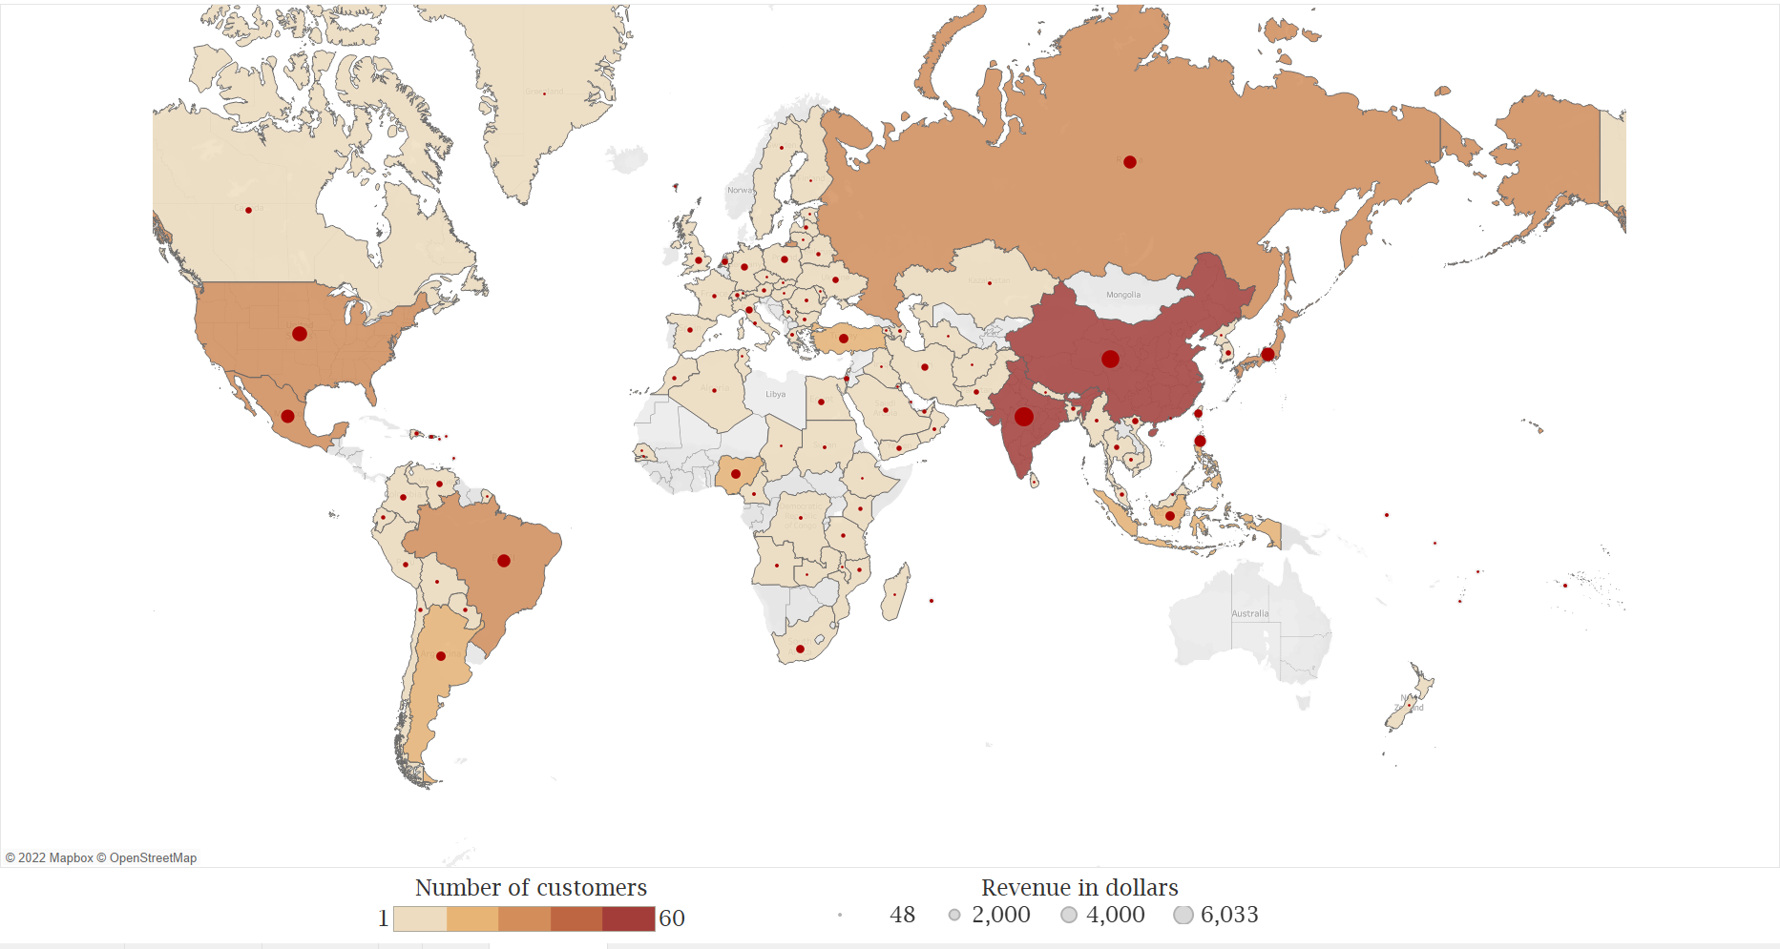
03
Which countries are Rockbuster customers based in?
Allocation of Rockbuster customers
-Rockbuster has customers based in 108 countries.
-The countries with the highest customer numbers include India(60), China(53) and United States(36) which together make up 24% of the total revenue.
-The countries with the lowest customer numbers include Afghanistan, Virgin Islands, and Tuvalu. All of them have only 1 customer and revenue from these countries together make up only 0.5% of the total revenue.

Slide 9
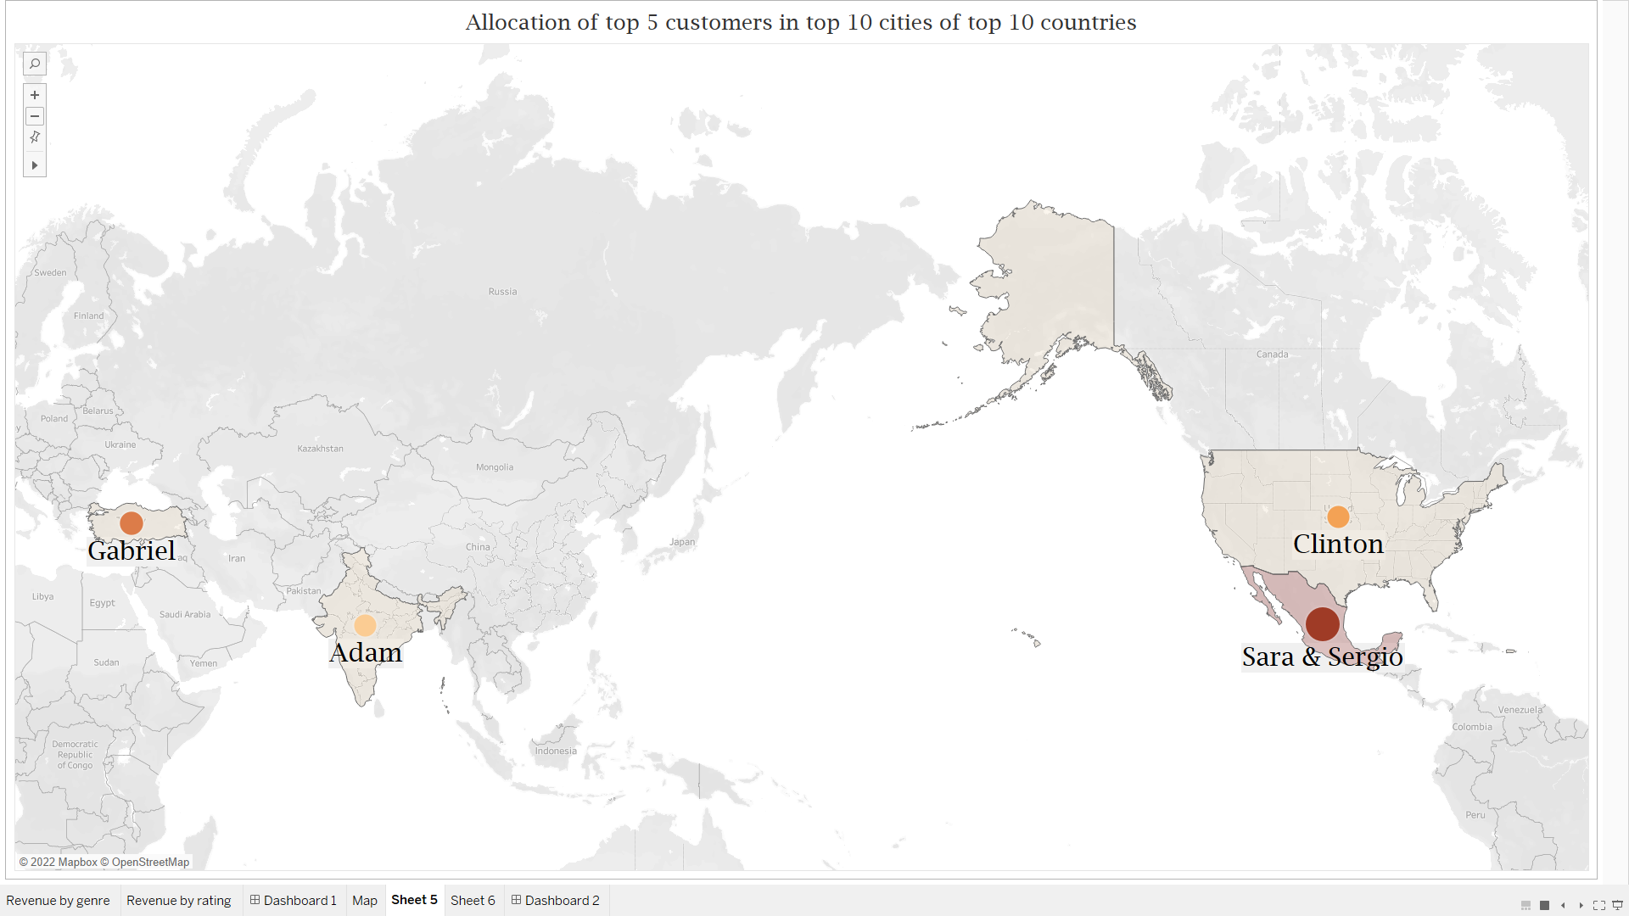
04
Where are customers with a high lifetime value based?
Top 5 customers in top 10 cities of top 10 countries
Name | Country | City | Total revenue | Rentals
Sara Perry | Mexico | Atlixco | $128.7 | 33
Gabriel Harder | Turkey | Sivas | $108.75 | 26
Sergio Stanfield | Mexico | Celaya | $102.76 | 26
Clinton Buford | United States | Aurora | $98.76 | 25
Adam Gooch | India | Adoni | $97.8 | 22
-2 of the top 5 customers in top 10 cities of top 10 countries reside in Mexico.
-Other top customers are based in Turkey, United States and India.

Slide 10
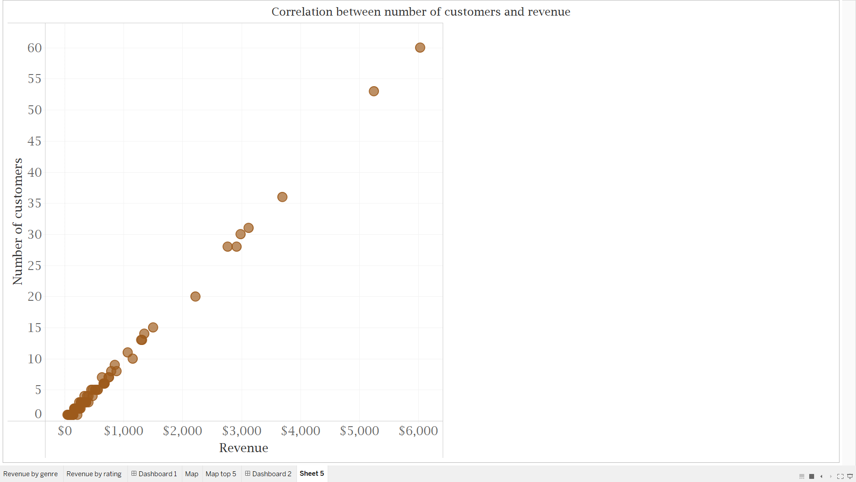
05
Do sales figures vary between geographic regions?
Relationship between customer count and revenue
-This graph shows the positive strong correlation between the number of customers and total revenue by country, or put another way, the countries with the highest number of customers bring the highest revenue.

Slide 11
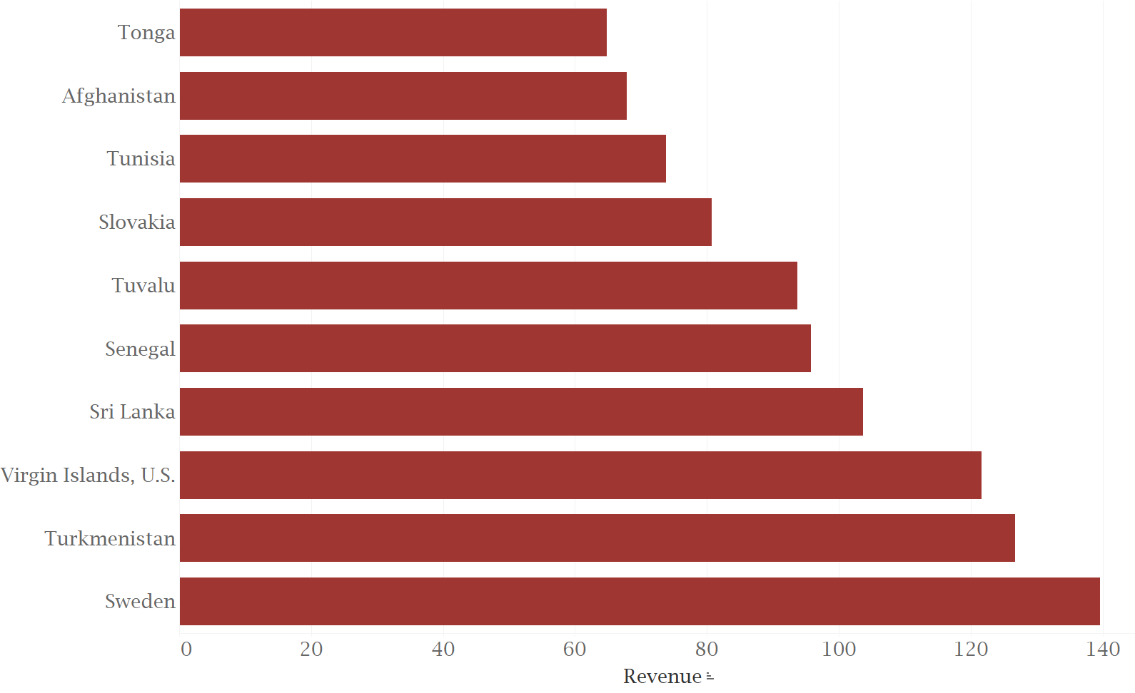
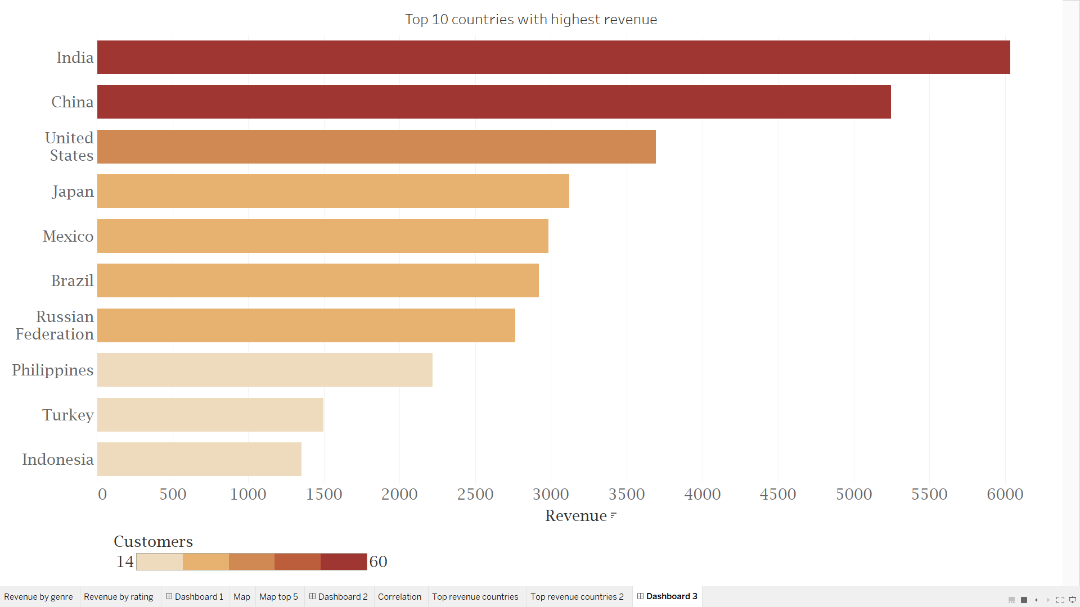
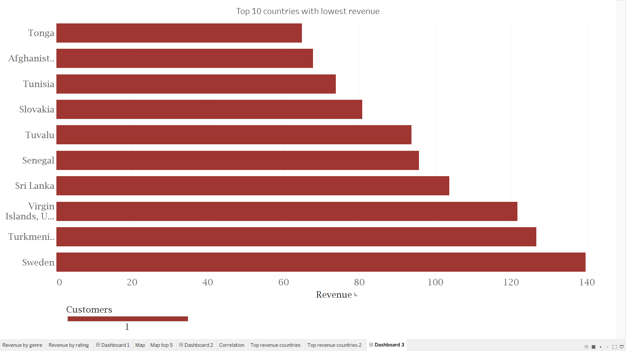
Top 10 countries with the highest revenue
Top 10 countries with the lowest revenue
The sales vary greatly between geographic regions. Countries like India and China bring the highest revenue more than $5000, while countries like Tonga and Afghanistan bring revenue lower than $80.

Slide 12
RECOMMENDATIONS
Focus on popular genres and ratings
Add more languages
Late returns -30% of revenue
All of the movies in the database are in English. In order to attract more customers from other regions, more languages should be added. Also the database contains missing data on payments and some inconsistencies regarding the release date of the movies.
India, China, USA
When adding new movies to the database or just streaming ads to attract new customers, focus on the highest revenue generating genres such as sports, sci-fi and animation rated PG-13, NC-17 or PG .
Region
Genre and Rating
Rental rate
Language and Database
Start from high revenue regions
Reassess the pricing strategy
Online streaming should be started from high revenue regions such as India, China and USA in order to ensure successful transition into online business.
Sports
PG-13
Almost half of the rentals were returned late and were charged with additional costs, which accounts for 30% of the total revenue. With online streaming, movies wouldn’t have to be returned, so there won’t be additional revenue. In order to keep the revenue at the same level, Rockbuster needs to either increase the prices or attract more customers.
Multi lingual

Slide 13
THANK YOU!
Link to visualizations: https://public.tableau.com/app/profile/munavvar.makhkamova
Email: munavvar.makhkamova@gmail.com

